Slide 1

Docker Monitoring & Logging - Day 3 (Conceptual & Architectural)

Slide 2
Agenda
Monitoring Containers
Visualization using Grafana
Logging Strategies with Docker
Centralized Logging with Loki
Metrics Collection with Prometheus
Architecture Deep Dive

Slide 3
01
Monitoring Containers

Slide 4
Why Monitor Docker Containers?
01
Ensure container health and availability
02
Track resource usage (CPU, Memory, Disk, Network)
03
Enable proactive alerting and scaling decisions
04
Identify performance bottlenecks and anomalies

Slide 5
What to Monitor?
Container Health Uptime, Restart count, Health checks
Resource Metrics CPU, Memory, Disk I/O, Network I/O
Application Logs Errors, Warnings, Debug Info
Infrastructure Events Start, stop, crashes, etc.

Slide 6
Monitoring Tools Overview
Grafana
Prometheus
cAdvisor
Docker Built- in Tools

Slide 7
02
Logging Strategies with Docker

Slide 8
Logging Tools Overview
Docker Logging Drivers:
Centralized Log Aggregation:

Slide 9
04
Metrics Collection with Prometheus

Slide 10
Prometheus Architecture for Docker Monitoring
01
02
03
04
Cadvisor Provides metrics from Docker containers
Prometheus Server Scrapes metrics from exporters
Service Discovery Configured with target IPs or services
Time- Series Database Stores metrics efficiently

Slide 11
05
Visualization using Grafana

Slide 12
Grafana Integration Overview
Creates dashboards and graphs for metrics
Supports alerting and notifications
Easy to share and export dashboards

Slide 13
06
Centralized Logging with Loki

Slide 14
Loki-based Logging Architecture
Grafana Unified UI for metrics and logs
Loki Indexes and stores logs (like Prometheus for logs)
Promtail Collects logs from container stdout

Slide 15
07
Architecture Deep Dive

Slide 16
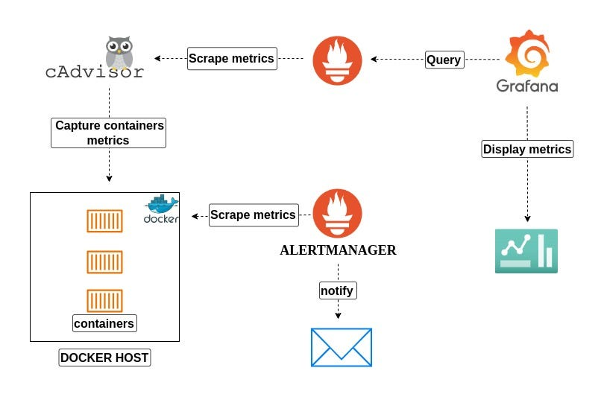
Monitoring Architecture Diagram

Slide 17
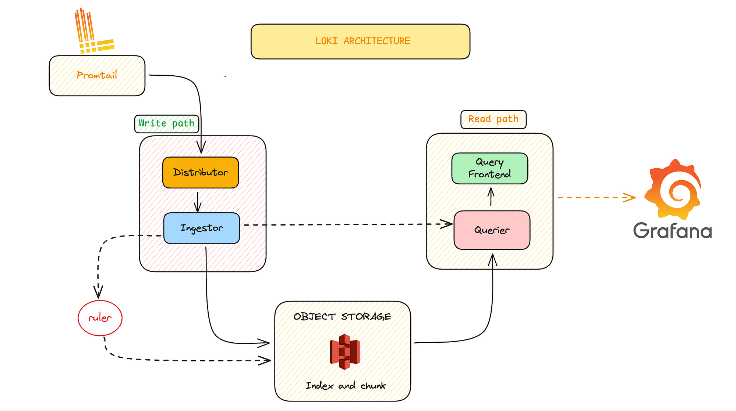
Logging Architecture Diagram

Slide 18
Benefits of Unified Monitoring & Logging
02
04
Faster troubleshooting and RCA
Scalable and open- source stack
01
03
Single- pane observability (Metrics + Logs)
Correlate spikes in metrics with logs

Slide 19
Summary
Understand what and why to monitor in containers
Leverage Prometheus for metrics
Use Grafana for powerful visualization
Centralized logging improves traceability
Combine metrics and logs for full observability
Summary

Slide 20
Discussion & Q/A
Let’s discuss your current Docker monitoring setup.

Slide 21
Thanks
Karthikeyan Vaiyapuri

